Slide 1
HPD
https://de05164.pythonanywhere.com/
팀원 : 김정안, 이경민, 백재호
얼마나 행복한가
Happy project
Happy solution
2025.11.13

Slide 2

Happy project
01 / 문제 정의
· 행복해야하는 이유
· 행복의 정의
· 행복의 수치화
02 / 분석과정
· Insert first text here
· Insert second text here
· Insert third text here
03 / 분석 결과
· Insert first text here
· Insert second text here
· Insert third text here
02
www.papatalabs.com

Slide 3

삶을 잘 살기 위한 MSG, 행복
Q. 왜 우리는 행복해야 하는가
A. 더 좋은 삶을 살고 생존하기 위해서
03
www.papatalabs.com

Slide 4
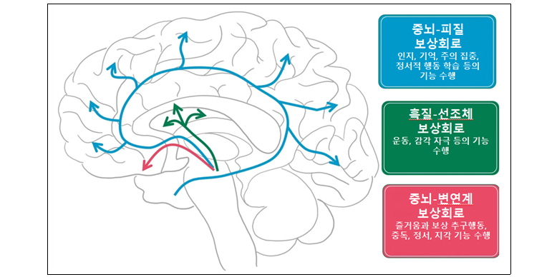
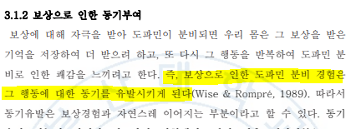
행복하면 좋은 이유
뇌과학적 측면에서 분석하기 위해
행복의 호르몬 “도파민“ 에대한 논문 자료참조
행복 호르몬 중 하나인 도파민의
긍정적 기능으로
삶의 동기 부여를 준다
삶의 목표를 이룰 가능성이 높아짐
[학위논문] 도파민의 구조와 기능
https://scienceon.kisti.re.kr/srch/selectPORSrchArticle.do?cn=DIKO0014194500

Slide 5

그럼 마약하면 성공한다는 말임?
연세 대학교 심리학과
서은국 교수
“장기전인 인생에서는
즐거움의 강도보단 빈도가 훨씬 중요하다”
쾌락(강한 즐거움)은 생존과 관련이 멀다
그러므로 진정 잘 살기 위해서는
지속적인 행복이 중요하다
03
www.papatalabs.com

Slide 6
그런데 우리는 행복하지 않다

Slide 7
문제정의
01
02
03
COPYRIGHT ⓒ ALL RIGHT RESERVED BY PAPATALABS
TEXT HERE
THE BEST TEMPLATE
FOR YOUR PRESENTATION
TEXT HERE
THE BEST TEMPLATE
FOR YOUR PRESENTATION
TEXT HERE
THE BEST TEMPLATE
FOR YOUR PRESENTATION
City of stars, Are you
shining just for me?
City of stars, There's so much that i can't see. Who knows I felt it from the first embrace
I shared with you.
City of stars, Are you
shining just for me?
City of stars, There's so much that i can't see. Who knows I felt it from the first embrace
I shared with you.
City of stars, Are you
shining just for me?
City of stars, There's so much that i can't see. Who knows I felt it from the first embrace
I shared with you.
03
www.papatalabs.com

Slide 8
문제정의
01
02
03
COPYRIGHT ⓒ ALL RIGHT RESERVED BY PAPATALABS
TEXT HERE
THE BEST TEMPLATE
FOR YOUR PRESENTATION
TEXT HERE
THE BEST TEMPLATE
FOR YOUR PRESENTATION
TEXT HERE
THE BEST TEMPLATE
FOR YOUR PRESENTATION
City of stars, Are you
shining just for me?
City of stars, There's so much that i can't see. Who knows I felt it from the first embrace
I shared with you.
City of stars, Are you
shining just for me?
City of stars, There's so much that i can't see. Who knows I felt it from the first embrace
I shared with you.
City of stars, Are you
shining just for me?
City of stars, There's so much that i can't see. Who knows I felt it from the first embrace
I shared with you.
03
www.papatalabs.com

Slide 9
분석 과정
행복과 관련된 요소와의 상관관계 분석
01
02
03
COPYRIGHT ⓒ ALL RIGHT RESERVED BY PAPATALABS
TEXT HERE
THE BEST TEMPLATE
FOR YOUR PRESENTATION
TEXT HERE
THE BEST TEMPLATE
FOR YOUR PRESENTATION
TEXT HERE
THE BEST TEMPLATE
FOR YOUR PRESENTATION
City of stars, Are you shining just for me?
City of stars, There's so much that i can't see. Who knows
I felt it from the first embrace I shared with you.
04
www.papatalabs.com

Slide 10
나라별 행복지수와 GDP의 산포도
TEXT HERE
THE BEST TEMPLATE
FOR YOUR PRESENTATION
TEXT HERE
THE BEST TEMPLATE
FOR YOUR PRESENTATION
TEXT HERE
THE BEST TEMPLATE
FOR YOUR PRESENTATION
COPYRIGHT ⓒ ALL RIGHT RESERVED BY PAPATALABS
TEXT HERE
THE BEST TEMPLATE
FOR YOUR PRESENTATION
TEXT HERE
THE BEST TEMPLATE
FOR YOUR PRESENTATION
TEXT HERE
THE BEST TEMPLATE
FOR YOUR PRESENTATION
05
www.papatalabs.com

Slide 11
연령별 스트레스 원인
10대부터 60대까지
THE BEST TEMPLATE FOR YOUR PRESENTATION | THE BEST TEMPLATE FOR YOUR PRESENTATION | THE BEST TEMPLATE FOR YOUR PRESENTATION
THE BEST TEMPLATE FOR YOUR PRESENTATION | THE BEST TEMPLATE FOR YOUR PRESENTATION | THE BEST TEMPLATE FOR YOUR PRESENTATION
THE BEST TEMPLATE FOR YOUR PRESENTATION | THE BEST TEMPLATE FOR YOUR PRESENTATION | THE BEST TEMPLATE FOR YOUR PRESENTATION
THE BEST TEMPLATE FOR YOUR PRESENTATION | THE BEST TEMPLATE FOR YOUR PRESENTATION | THE BEST TEMPLATE FOR YOUR PRESENTATION
COPYRIGHT ⓒ ALL RIGHT RESERVED BY PAPATALABS
06
www.papatalabs.com

Slide 12

Thank you
PAPATA
LABS DESIGN
COPYRIGHT ⓒ ALL RIGHT RESERVED BY PAPATALABS
www.papatalabs.com

Slide 13
SYSTEM
COLOR
LINE
FONT
#404040
#262626
나눔스퀘어
다운로드
#D9D9D9
#7F7F7F

